Slide 1

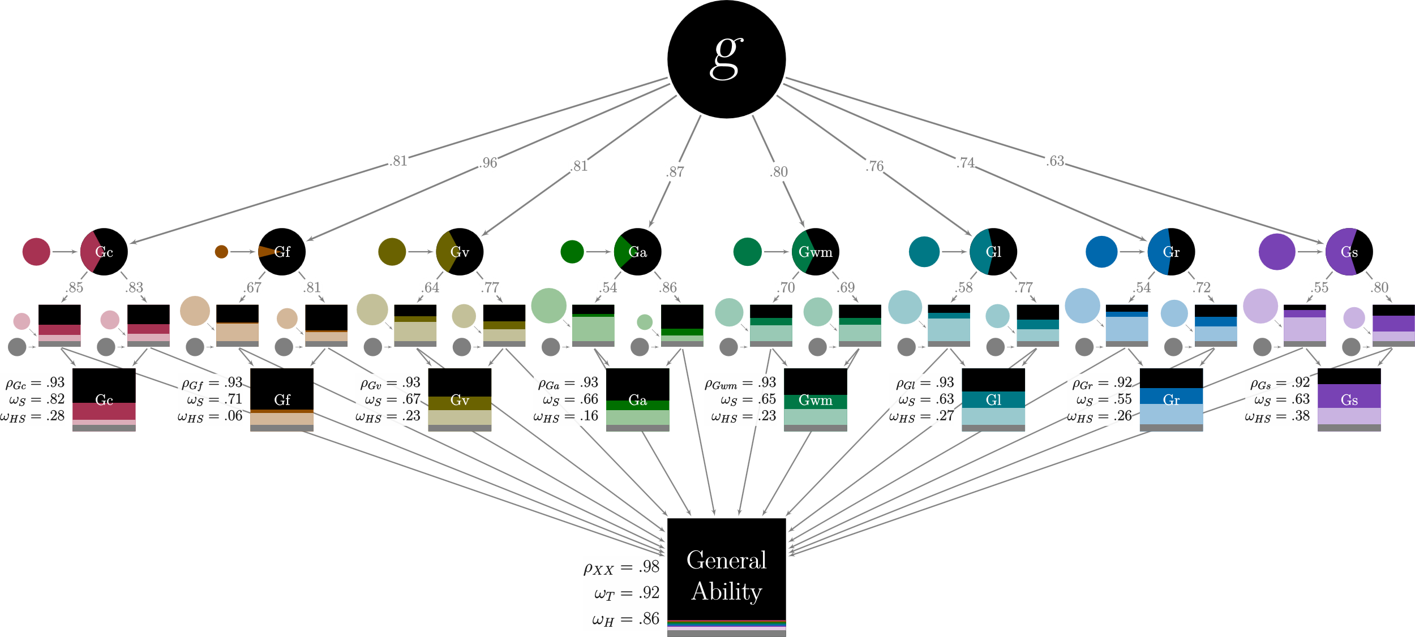
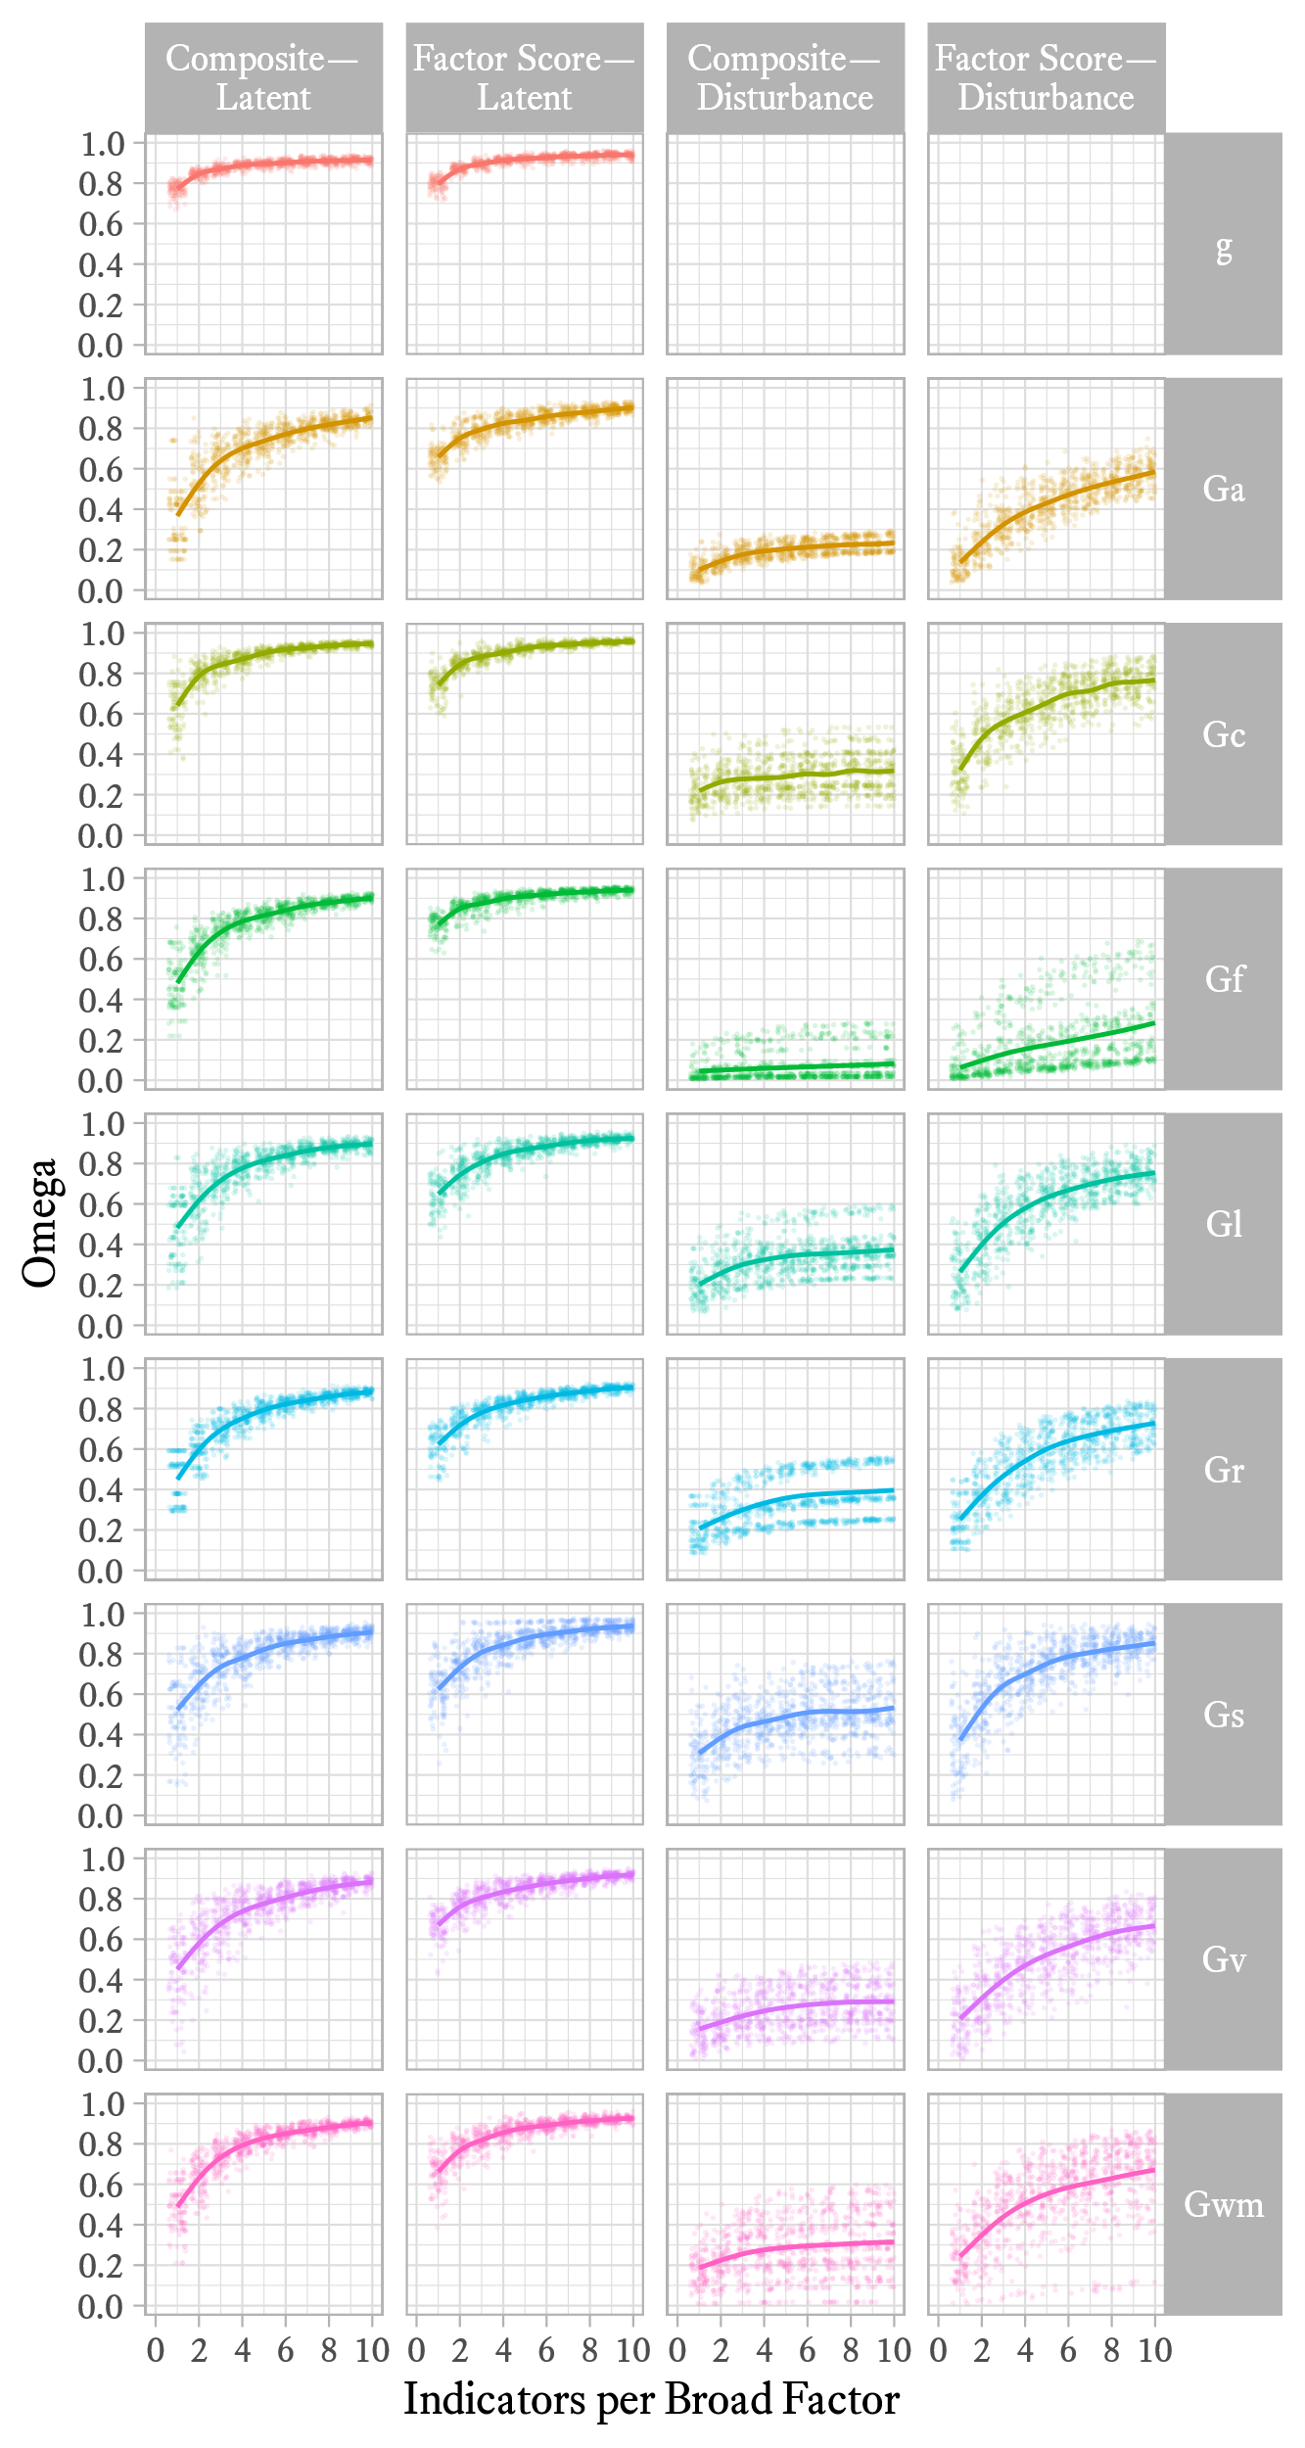
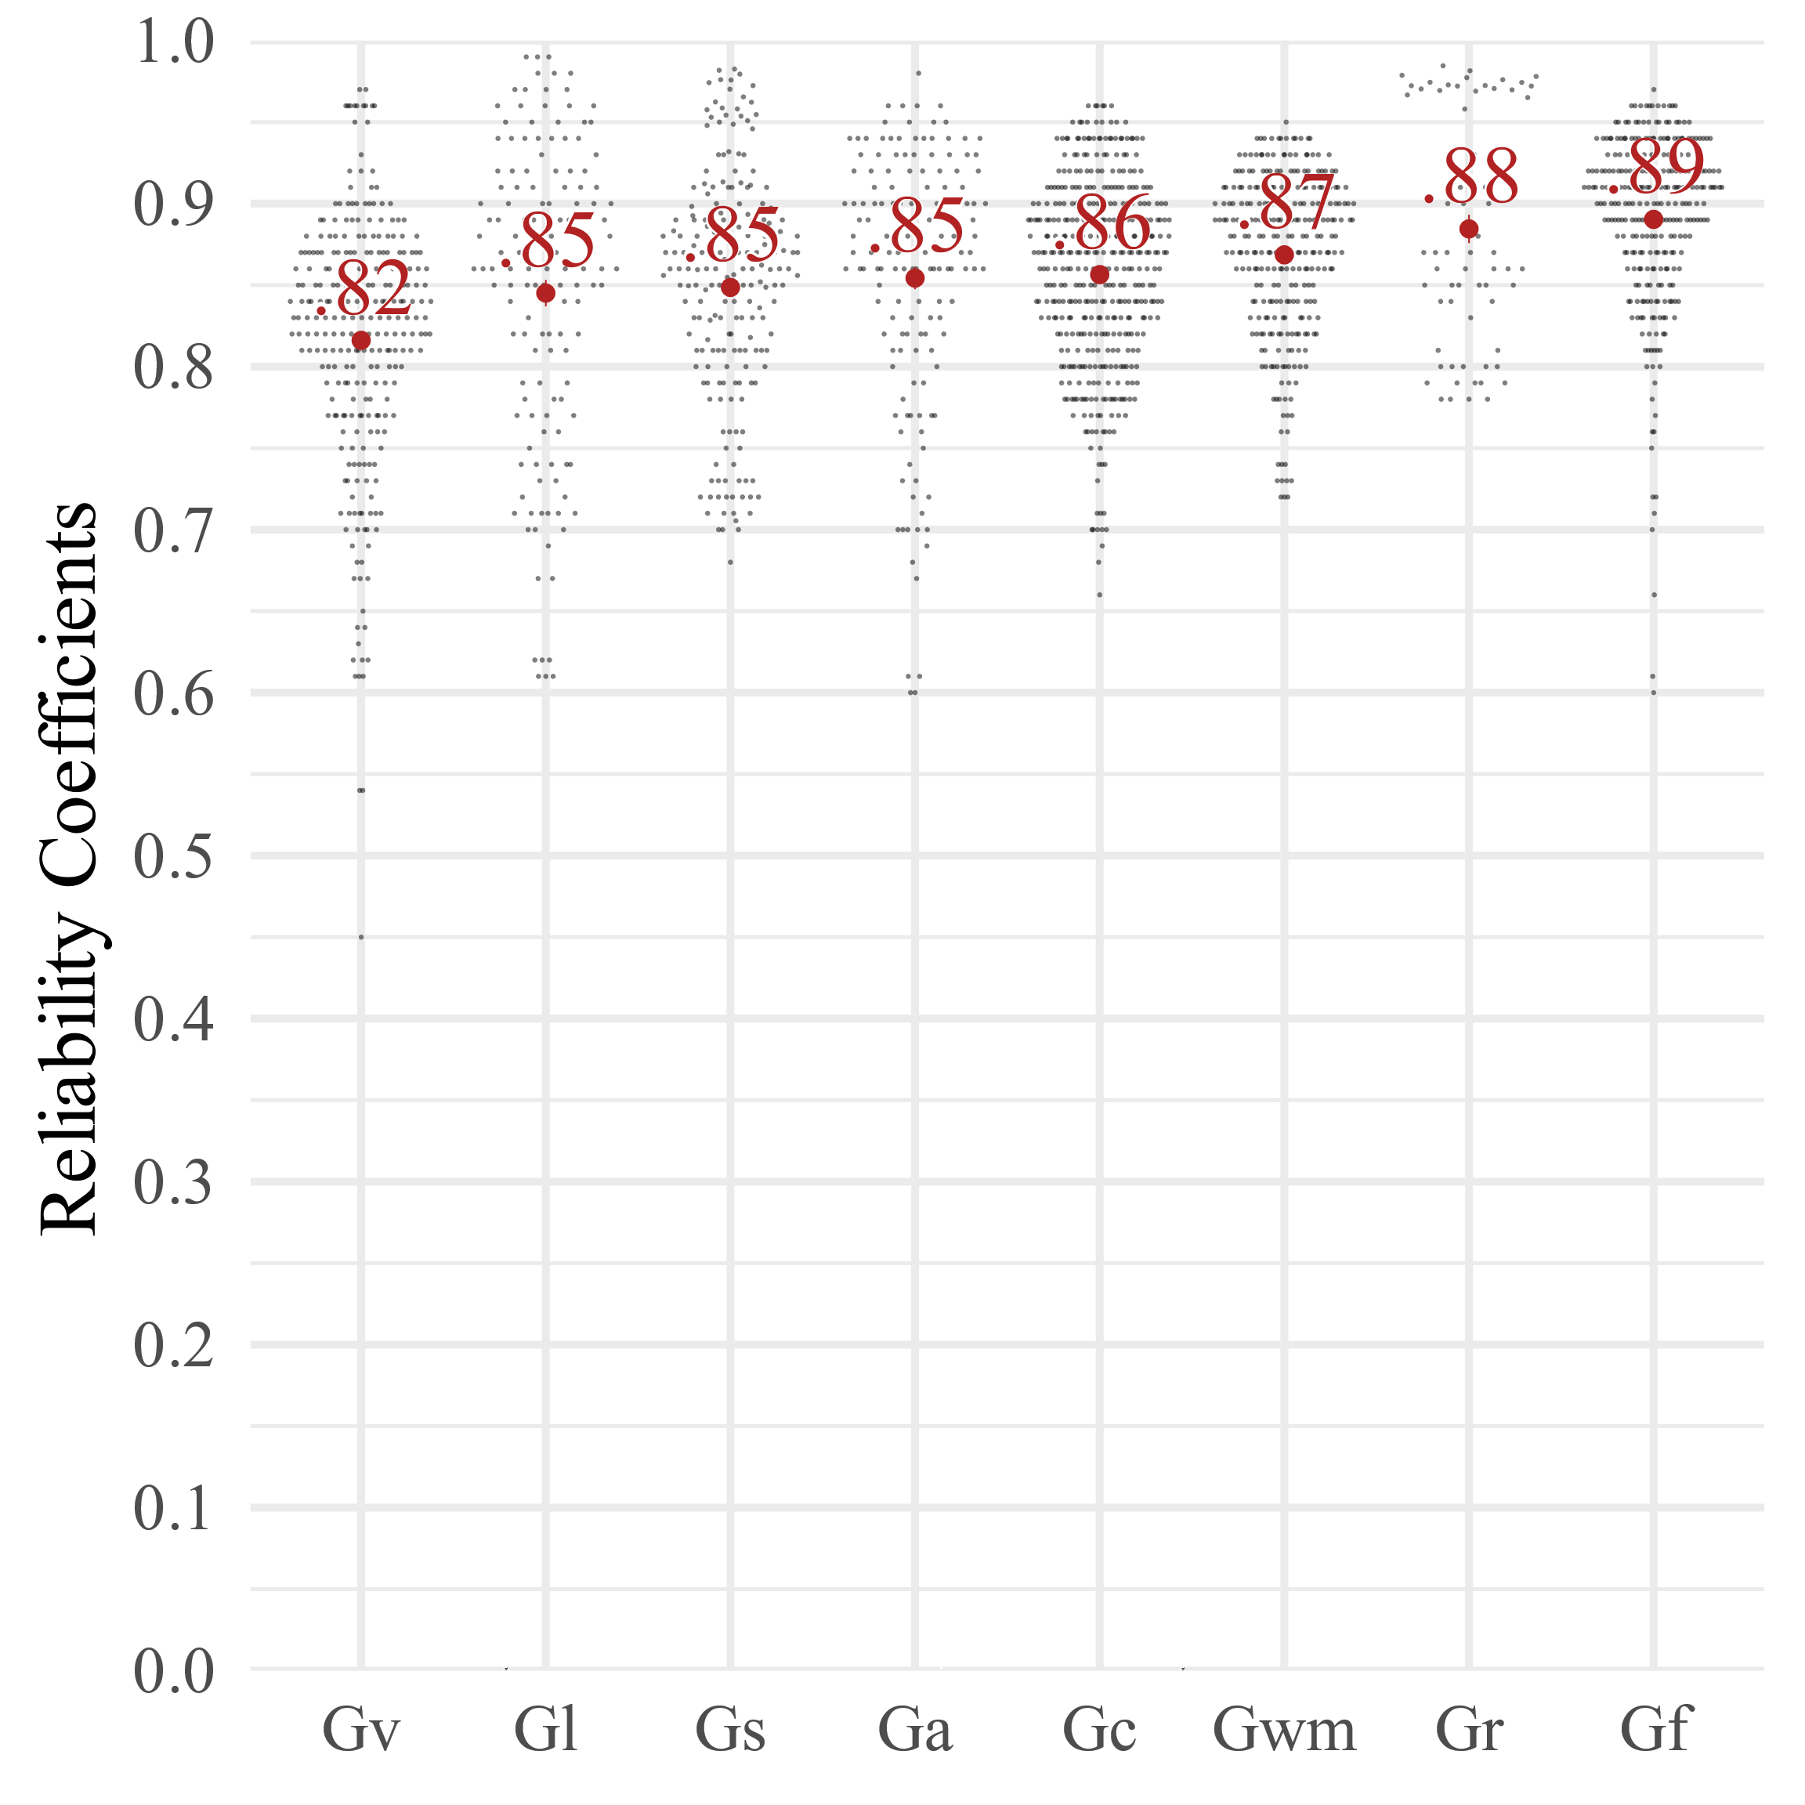
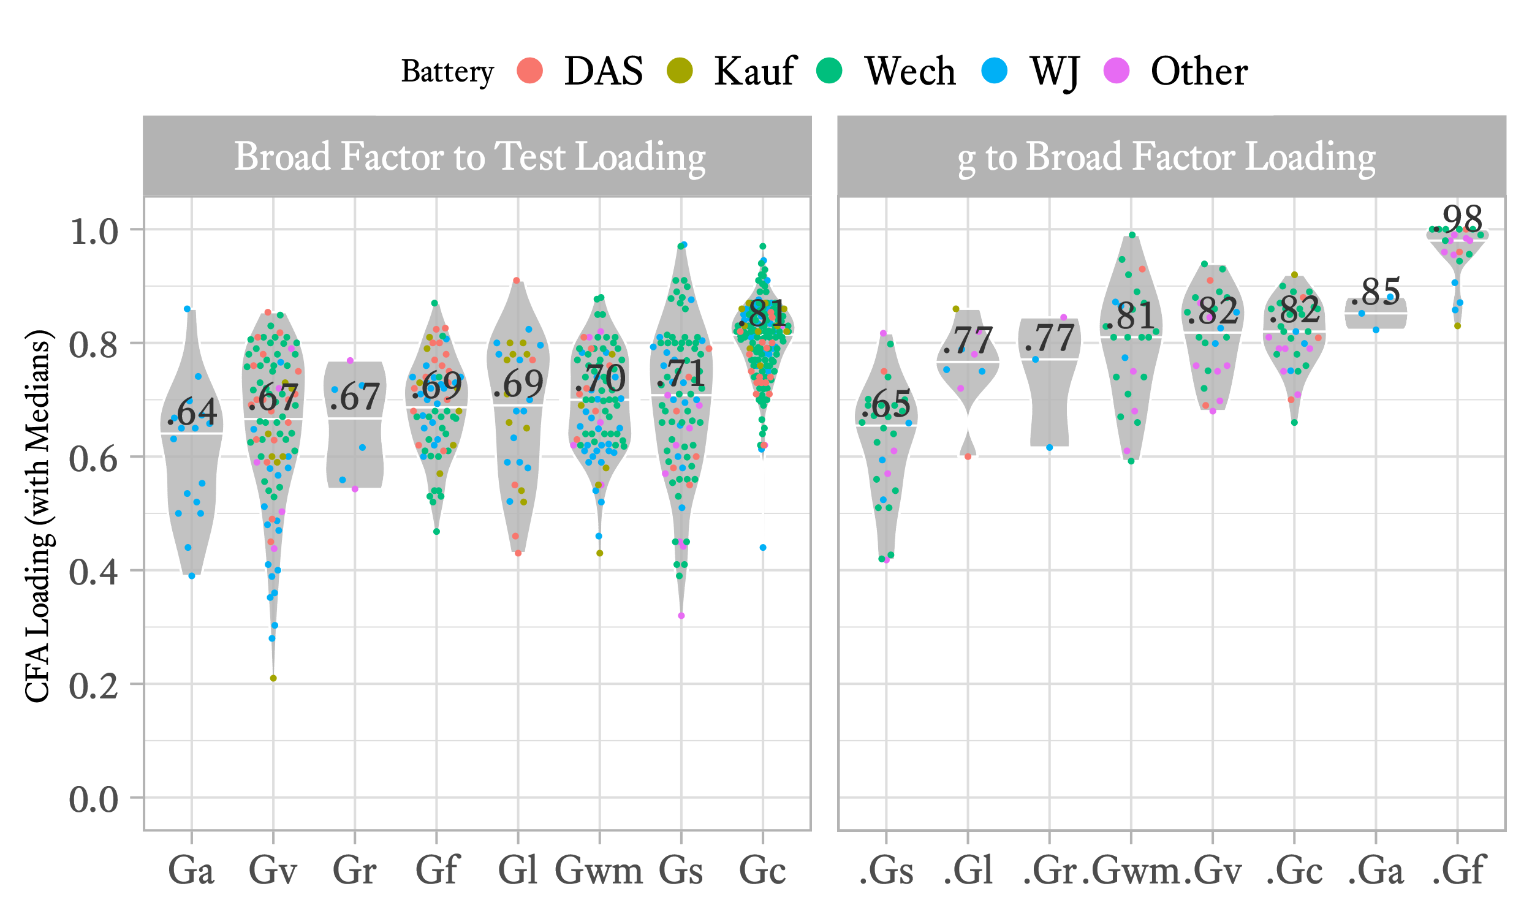
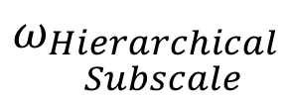
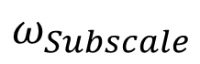
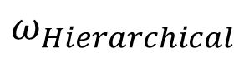
Broad Abilities Are Not Doomed To Be Measured Unreliably: A Monte Carlo Study of Omega Statistics
W. Joel Schneider & Catherine A. Fiorello
Introduction
Some scholars argue that only the general factor of intelligence is measured well enough by existing ability tests to be of practical use (e.g., Canivez, Watkins, & Dombrowski, 2017; Dombrowski, Canivez, Watkins, & Beaujean, 2015; Gignac & Watkins, 2013). This argument has multiple components and several lines of evidence, each of which must be addressed separately. Here we address only one (heavily emphasized) component of their argument: As measured by the ω hierarchical subscale statistic (McDonald, 1999), broad ability composites typically have “low reliability” after the general factor variance is removed.
We believe this argument to be misleading in several ways:
Broad ability composites are designed to measure g-loaded constructs. To fault a composite score for fulfilling its mission is unfair. Broad ability composites operationalize latent ability constructs from the higher-order model—constructs that have a lot of g variance in them. As seen in Figure 1, the broad ability latent variables have large amounts of g variance in them. The Gf latent variable is almost entirely composed of g variance and the Gs latent variable has much more disturbance variance (d.Gs). Ideally, a broad ability composite should have as much g variance as the construct it operationalizes. Thus, a good Gf composite should mostly consist of g variance and a good Gs composite should consist of much less g variance.
The ω hierarchical subscale statistic typically excludes the unique contributions of narrow abilities. There is nothing wrong with ω hierarchical subscale statistic, but it can be misinterpreted. When it is low, it does not necessarily mean that the composite score has little amounts of construct-relevant variance. In most studies, each broad ability is measured by 2 or 3 indicators. Each indicator usually operationalizes a different narrow ability. The ω hierarchical subscale statistic does not include variance from the narrow ability disturbance terms. For example, suppose you measure comprehension/knowledge (Gc) with a composite formed by an oral comprehension test and a vocabulary test. The ω hierarchical subscale statistic for this composite will only estimate the common variance between the two tests (after removing the effects of g). If you believe that the unique contribution of vocabulary and the unique contribution of oral comprehension are part of the Gc construct, then the ω hierarchical subscale statistic underestimates how well the construct is measured. In Figure 1, the ω hierarchical subscale statistic for Gc will indicate the proportion of the composite score that is dark red. The light red proportion is specific variance, much of which is from narrow ability disturbance terms (i.e., the unique aspects of narrow abilities).
If we want to measure g-less constructs, we need to do so with scores designed for that purpose. There are methods available to operationalize the g-free disturbance terms for higher-order broad and narrow ability constructs or the g-free group factors of bifactor models (Schneider, 2013). If these scores fail to adequately operationalize their intended constructs, it is fair to warn against their use.
Clinicians will generally find g-less scores to be of limited use. Clinicians want to know how well a person can perform in a specific domain. A g-less working memory score, for example, does not tell indicate how well a person can perform working memory tasks. Working memory has g variance in it, and thus clinicians need a working memory score with g variance in it. That said, a g-less score can help the clinician decide if the broad ability is significantly higher or lower than the general ability score (Schneider, 2013).
The aims of this study are to use simulated data based on existing factor-analytic studies of Cattell-Horn-Carroll Theory (CHC) constructs (McGrew, 2005; Schneider & McGrew, 2018) to show that:
The ω hierarchical subscale statistic will be low no matter how many indicators a broad CHC ability composite has.
Scores designed to measure g-less broad ability disturbance terms approximate their intended constructs better as the number of indicators increase.
Method
We sampled subtest reliability coefficients from the DAS-II, KABC-II, WISC-V, WAIS-IV, WJ III, and WJ IV. As seen in Figure 2, reliability coefficients have a wide range, but are generally comparable across broad ability constructs, with most coefficients in the mid .80s and low .90s.
To create simulated data sets resembling existing higher-order models of intelligence, we sampled loadings from 35 studies conducing confirmatory factor analyses of CHC constructs. As seen in Figure 3, fluid intelligence (Gf) is nearly indistinguishable from general intelligence (g) and processing speed (Gs) has the lowest g loading. Comprehension-Knowledge (Gc) tests have noticeably higher loadings compared to other abilities.
Data were simulated in R using custom code and the simstandard package (Schneider, 2018). All code is available on https://github.com/wjschne/APA2019. Each test was assigned a randomly sampled broad ability loading and a randomly sampled reliability coefficient. Models were created with 1 to 10 indicators per broad ability construct. At each value for the number of indicators, 100 models were randomly sampled. Thus, 1000 models were created in total. Composite scores and Thurstone factor scores were created to operationalize latent variables and their disturbance terms using methods from Schneider (2013, 2018).
Results and Discussion
As seen in Figure 4, broad ability composites and latent factor scores operationalize their constructs reasonably well with 2 indicators and increasingly well as the number of indicators rises. Gf is difficult to disentangle from g, except in extreme cases (e.g., in individuals with traumatic brain injury). Factor score measures of broad ability constructs outperform equal-unit composites. The ω hierarchical subscale statistic remains low even with an infinite number of indicators because a composite score always retains large amounts of g variance. However, factor scores designed to remove g variance become increasingly better measures of g-less ability constructs as the number of indicators rises.
We recommend that for routine use, at least 2 indicators per factor be used for broad ability composites. However, if a broad ability needs to be distinguished from g, we recommend that 4 or more qualitatively different measures of the ability be used. Statistical tests for doing so are given in Schneider (2013). However, because the factor score measures of g-less constructs have relatively low levels of reliability, we recommend using confidence intervals around the score. The confidence intervals will typically be wide and thus only informative for extreme scores.
Figure 1. Omega Statistics for a Model with Randomly Selected Loadings
Gs is the only broad ability that has more disturbance variance than g variance.
ω hierarchical subscale for Gc measures the dark red proportion of variance.
ω hierarchical subscale for Gv excludes the light green proportion of variance due to narrow and specific abilities.
$$ω_{Hierarchical}$$
ω hierarchical for General Ability excludes the variance due to broad, narrow, and specific abilities.
$$ω_{Subscale}$$
$$ω_{\begin{aligned}Hierarchical \\ Subscale\end{aligned}}$$
Figure 2. Distribution of Reliability Coefficients from Major Cognitive Ability Batteries by CHC Constructs
Figure 3. Distribution of Factor Loadings from Confirmatory Factor Analyses of CHC Constructs
Figure 4. How ω Coefficients Rise as the Number of Indicators Per Factor Increases

